Slide 1


Python Programming Ⅰ
week 8

Slide 2
Python: Data Structures Dictionaries, Sets, Sequences

Slide 3
Python: Dictionaries
{ , , , }

Slide 4
Topic Structure
Task | Single Value | Multiple Values | numpy, pandas
Presentation (value, variable) | int, float, string, boolean | list, tuple, dictionary, set | ndarray, Series, DataFrame
Operation (algebra) | expressions | operations, mutable operations | expressions, get, set, reshape, …
Control flow | if for while
Use and reuse | Functions Standard libraries Modules and Packages
Input and output | Standard I/O File I/O |  | Standard I/O File I/O CSV, Excel

Slide 5
Learning Objectives
Dictionaries
Getting Elements from a Dictionary
Changing Elements in a Dictionary

Slide 6
Dictionary
A dictionary is like an address-book where you can find the address or contact details of a person by knowing only his/her name i.e. we associate keys (name) with values (details).
You can use only immutable objects (like strings) for the keys of a dictionary but you can use either immutable or mutable objects for the values of the dictionary.
Pairs of keys and values are specified in a dictionary by using the notation d = { key1 : value1, key2 : value2 }
Remember that key-value pairs in a dictionary are not ordered in any manner.

Slide 7
Sequence: Dictionary
for i in {
'Swaroop': 'swaroop@swaroopch.com',
'Larry': 'larry@wall.org',
'Matsumoto': 'matz@ruby-lang.org',
'Spammer': 'spammer@hotmail.com'
}:
print(i)
s = {
'Swaroop': 'swaroop@swaroopch.com',
'Larry': 'larry@wall.org',
'Matsumoto': 'matz@ruby-lang.org',
'Spammer': 'spammer@hotmail.com'
}
for i in s:
print(i)

Slide 8
Sequence: Dictionary
for i, j in {
'Swaroop': 'swaroop@swaroopch.com',
'Larry': 'larry@wall.org',
'Matsumoto': 'matz@ruby-lang.org',
'Spammer': 'spammer@hotmail.com'
}.items():
print(i, j)
s = {
'Swaroop': 'swaroop@swaroopch.com',
'Larry': 'larry@wall.org',
'Matsumoto': 'matz@ruby-lang.org',
'Spammer': 'spammer@hotmail.com'
}
for i, j in s.items():
print(i, j)

Slide 9
Learning Objectives
Dictionaries
Getting Elements from a Dictionary
Changing Elements in a Dictionary

Slide 10
Dictionary: s[key] or s.get(key)
s = {
"Swaroop": "swaroop@swaroopch.com",
"Larry": "larry@wall.org",
"Matsumoto": "matz@ruby-lang.org",
"Spammer": "spammer@hotmail.com"
}
print(s["Larry"])
s = {
"Swaroop": "swaroop@swaroopch.com",
"Larry": "larry@wall.org",
"Matsumoto": "matz@ruby-lang.org",
"Spammer": "spammer@hotmail.com"
}
print(s.get("Larry"))

Slide 11
Dictionary: s.keys()
s = {
"Swaroop": "swaroop@swaroopch.com",
"Larry": "larry@wall.org",
"Matsumoto": "matz@ruby-lang.org",
"Spammer": "spammer@hotmail.com"
}
print(s.keys())

Slide 12
Example: s.keys()
s = {
"Swaroop": "swaroop@swaroopch.com",
"Larry": "larry@wall.org",
"Matsumoto": "matz@ruby-lang.org",
"Spammer": "spammer@hotmail.com"
}
for sKey in s.keys():
print(s[sKey])
s = {
"Swaroop": "swaroop@swaroopch.com",
"Larry": "larry@wall.org",
"Matsumoto": "matz@ruby-lang.org",
"Spammer": "spammer@hotmail.com"
}
for sKey in s:
print(s[sKey])

Slide 13
Example: s.keys()
s = {
"Swaroop": "swaroop@swaroopch.com",
"Larry": "larry@wall.org",
"Matsumoto": "matz@ruby-lang.org",
"Spammer": "spammer@hotmail.com"
}
for sKey in s.keys():
print(s[sKey])
s = {
"Swaroop": "swaroop@swaroopch.com",
"Larry": "larry@wall.org",
"Matsumoto": "matz@ruby-lang.org",
"Spammer": "spammer@hotmail.com"
}
for sKey in s:
print(s[sKey])

Slide 14
Example: Ordering s.keys()
s = {
"Swaroop": "swaroop@swaroopch.com",
"Larry": "larry@wall.org",
"Matsumoto": "matz@ruby-lang.org",
"Spammer": "spammer@hotmail.com"
}
lsKey = list(s.keys())
print(lsKey)
lsKey.sort()
print(lsKey)
for sKey in lsKey:
print(s[sKey])

Slide 15
Dictionary: s.values()
s = {
"Swaroop": "swaroop@swaroopch.com",
"Larry": "larry@wall.org",
"Matsumoto": "matz@ruby-lang.org",
"Spammer": "spammer@hotmail.com"
}
print(s.values())

Slide 16
Example: s.values()
s = {
"Swaroop": "swaroop@swaroopch.com",
"Larry": "larry@wall.org",
"Matsumoto": "matz@ruby-lang.org",
"Spammer": "spammer@hotmail.com"
}
lsValue = list(s.values())
lsValue.sort()
print(lsValue)

Slide 17
Dictionary: s.items()
s = {
"Swaroop": "swaroop@swaroopch.com",
"Larry": "larry@wall.org",
"Matsumoto": "matz@ruby-lang.org",
"Spammer": "spammer@hotmail.com"
}
print(s.items())

Slide 18
Example: s.items()
s = {
"Swaroop": "swaroop@swaroopch.com",
"Larry": "larry@wall.org",
"Matsumoto": "matz@ruby-lang.org",
"Spammer": "spammer@hotmail.com"
}
for sKey, sValue in s.items():
print(sKey, sValue)

Slide 19
Example: s.items()
s = {
"Swaroop": "swaroop@swaroopch.com",
"Larry": "larry@wall.org",
"Matsumoto": "matz@ruby-lang.org",
"Spammer": "spammer@hotmail.com"
}
print(list(s.items()))

Slide 20
Dictionary: x in s
s = {
"Swaroop": "swaroop@swaroopch.com",
"Larry": "larry@wall.org",
"Matsumoto": "matz@ruby-lang.org",
"Spammer": "spammer@hotmail.com"
}
if "a" in s:
print("exist")
else:
print("not exist")

Slide 21
Dictionary: x not in s
s = {
"Swaroop": "swaroop@swaroopch.com",
"Larry": "larry@wall.org",
"Matsumoto": "matz@ruby-lang.org",
"Spammer": "spammer@hotmail.com"
}
if "a" not in s:
print("not exist")
else:
print("exist")

Slide 22
Example: x in s
s = {
"Swaroop": "swaroop@swaroopch.com",
"Larry": "larry@wall.org",
"Matsumoto": "matz@ruby-lang.org",
"Spammer": "spammer@hotmail.com"
}
print(s["a"]) # ERROR

Slide 23
Example: x in s
s = {
"Swaroop": "swaroop@swaroopch.com",
"Larry": "larry@wall.org",
"Matsumoto": "matz@ruby-lang.org",
"Spammer": "spammer@hotmail.com"
}
print(s["a"]) # ERROR
s = {
"Swaroop": "swaroop@swaroopch.com",
"Larry": "larry@wall.org",
"Matsumoto": "matz@ruby-lang.org",
"Spammer": "spammer@hotmail.com"
}
if "a" in s:
print(s["a"])

Slide 24
Example: x in s
s = {
"Swaroop": "swaroop@swaroopch.com",
"Larry": "larry@wall.org",
"Matsumoto": "matz@ruby-lang.org",
"Spammer": "spammer@hotmail.com"
}
while True:
sKey = input("Type name to query ... ")
if sKey == 'quit':
break
elif sKey in s:
print(s[sKey])
else:
print("no data")

Slide 25
Example: Concatenation of Dictionaries
s = {
"Swaroop": "swaroop@swaroopch.com",
"Larry": "larry@wall.org",
"Matsumoto": "matz@ruby-lang.org",
"Spammer": "spammer@hotmail.com"
}
t = {
"cho": "ancestor9@gmail.com",
"Kim": "kim@hotmail.com",
"Hong": "hong@hanmail.net"
}
st = s + t # ERROR
print(st)

Slide 26
Example: Concatenation of Dictionaries
s = {
"Swaroop": "swaroop@swaroopch.com",
"Larry": "larry@wall.org",
"Matsumoto": "matz@ruby-lang.org",
"Spammer": "spammer@hotmail.com"
}
t = {
"Song": "yusong@gmail.com",
"Kim": "kim@hotmail.com",
"Hong": "hong@hanmail.net"
}
st = dict(list(s.items()) + list(t.items()))
print(st)

Slide 27
Example: Concatenation of Dictionaries
s = {
"Swaroop": "swaroop@swaroopch.com",
"Larry": "larry@wall.org",
"Matsumoto": "matz@ruby-lang.org",
"Spammer": "spammer@hotmail.com"
}
t = {
"Song": "yusong@gmail.com",
"Kim": "kim@hotmail.com",
"Hong": "hong@hanmail.net"
}
st = dict(list(s.items()) + list(t.items()))
print(st)
s = {
"Swaroop": "swaroop@swaroopch.com",
"Larry": "larry@wall.org",
"Matsumoto": "matz@ruby-lang.org",
"Spammer": "spammer@hotmail.com"
}
t = {
"Song": "yusong@gmail.com",
"Kim": "kim@hotmail.com",
"Hong": "hong@hanmail.net"
}
st = s + t # ERROR
print(st)

Slide 28
Dictionary: Adding s to Itself n Times
s = {
"Swaroop": "swaroop@swaroopch.com",
"Larry": "larry@wall.org",
"Matsumoto": "matz@ruby-lang.org",
"Spammer": "spammer@hotmail.com"
}
s3 = s * 3 # ERROR
print(s3)

Slide 29
Dictionary: Adding s to Itself n Times
s = {
"Swaroop": "swaroop@swaroopch.com",
"Larry": "larry@wall.org",
"Matsumoto": "matz@ruby-lang.org",
"Spammer": "spammer@hotmail.com"
}
s3 = dict(list(s.items()) * 3) # non-sense
print(s3)

Slide 30
Dictionary: len(s), min(s), max(s)
s = {
4: "swaroop@swaroopch.com",
1: "larry@wall.org",
2: "matz@ruby-lang.org",
3: "spammer@hotmail.com"
}
print(len(s))
print(min(s))
print(max(s))
# Numerical order
s = {
"Swaroop": "swaroop@swaroopch.com",
"Larry": "larry@wall.org",
"Matsumoto": "matz@ruby-lang.org",
"Spammer": "spammer@hotmail.com"
}
print(len(s))
print(min(s))
print(max(s))
# Lexicographical order

Slide 31
Learning Objectives
Dictionaries
Getting Elements from a Dictionary
Changing Elements in a Dictionary

Slide 32
Dictionary: s[key] = x (value of s[key] is replaced by x)
s = {
"Swaroop": "swaroop@swaroopch.com",
"Larry": "larry@wall.org",
"Matsumoto": "matz@ruby-lang.org",
"Spammer": "spammer@hotmail.com"
}
s["Swaroop"] = “ancestor9@gmail.com"
print(s)

Slide 33
Dictionary: s[key] = x (new (key, value) pair is added)
s = {
"Swaroop": "swaroop@swaroopch.com",
"Larry": "larry@wall.org",
"Matsumoto": "matz@ruby-lang.org",
"Spammer": "spammer@hotmail.com"
}
s["Zo"] = "ancestor9@gmail.com"
print(s)

Slide 34
Example: Adding Items to a Dictionary
s = {
"Swaroop": "swaroop@swaroopch.com",
"Larry": "larry@wall.org",
"Matsumoto": "matz@ruby-lang.org",
"Spammer": "spammer@hotmail.com"
}
while True:
print(s)
sKey = input("Type a name ... ")
if sKey == "quit":
break
else:
sValue = input("Type his/her e-mail address ... ")
s[sKey] = sValue
print("Added")

Slide 35
Dictionary: del s[key]
s = {
"Swaroop": "swaroop@swaroopch.com",
"Larry": "larry@wall.org",
"Matsumoto": "matz@ruby-lang.org",
"Spammer": "spammer@hotmail.com"
}
del s["Swaroop"]
print(s)

Slide 36
Example: Removing Items from a Dictionary
s = {
"Swaroop": "swaroop@swaroopch.com",
"Larry": "larry@wall.org",
"Matsumoto": "matz@ruby-lang.org",
"Spammer": "spammer@hotmail.com"
}
while True:
print(s)
sKey = input("Type a name ... ")
if sKey == "quit":
break
elif sKey in s:
del s[sKey]
print("Removed")
else:
print("Nothing to remove")

Slide 37
Dictionary: s.clear() (removes all items from s)
s = {
"Swaroop": "swaroop@swaroopch.com",
"Larry": "larry@wall.org",
"Matsumoto": "matz@ruby-lang.org",
"Spammer": "spammer@hotmail.com"
}
s.clear()
print(s)

Slide 38
Dictionary: s.copy() (creates a shallow copy of s)
s = {
"Swaroop": "swaroop@swaroopch.com",
"Larry": "larry@wall.org",
"Matsumoto": "matz@ruby-lang.org",
"Spammer": "spammer@hotmail.com"
}
t = s.copy()
print(t)

Slide 39
Dictionary: s.pop(key) (retrieves the value of s[key] and also removes it from s)
s = {
"Swaroop": "swaroop@swaroopch.com",
"Larry": "larry@wall.org",
"Matsumoto": "matz@ruby-lang.org",
"Spammer": "spammer@hotmail.com"
}
sValue = s.pop("Swaroop")
print(sValue)
print(s)

Slide 40
Example: Removing Items from a Dictionary
s = {
"Swaroop": "swaroop@swaroopch.com",
"Larry": "larry@wall.org",
"Matsumoto": "matz@ruby-lang.org",
"Spammer": "spammer@hotmail.com"
}
while True:
print(s)
sKey = input("Type a name ... ")
if sKey == "quit":
break
elif sKey in s:
sValue = s.pop(sKey)
print("Removed", sKey, sValue)
else:
print("Nothing to remove")

Slide 41
Example: Removing Items from a Dictionary
s = {
"Swaroop": "swaroop@swaroopch.com",
"Larry": "larry@wall.org",
"Matsumoto": "matz@ruby-lang.org",
"Spammer": "spammer@hotmail.com"
}
while True:
print(s)
sKey = input("Type a name ... ")
if sKey == "quit":
break
elif sKey in s:
sValue = s.pop(sKey)
print("Removed", sKey, sValue)
else:
print("Nothing to remove")
s = {
"Swaroop": "swaroop@swaroopch.com",
"Larry": "larry@wall.org",
"Matsumoto": "matz@ruby-lang.org",
"Spammer": "spammer@hotmail.com"
}
while True:
print(s)
sKey = input("Type a name ... ")
if sKey == "quit":
break
elif sKey in s:
del s[sKey]
print("Removed")
else:
print("Nothing to remove")

Slide 42
Example: Removing Items from a Dictionary
s = {
"Swaroop": "swaroop@swaroopch.com",
"Larry": "larry@wall.org",
"Matsumoto": "matz@ruby-lang.org",
"Spammer": "spammer@hotmail.com"
}
while True:
print(s)
sKey = input("Type a name ... ")
if sKey == "quit":
break
elif sKey in s:
sValue = s.pop(sKey)
print("Removed", sKey, sValue)
else:
print("Nothing to remove")
s = {
"Swaroop": "swaroop@swaroopch.com",
"Larry": "larry@wall.org",
"Matsumoto": "matz@ruby-lang.org",
"Spammer": "spammer@hotmail.com"
}
while True:
print(s)
sKey = input("Type a name ... ")
if sKey == "quit":
break
elif sKey in s:
del s[sKey]
print("Removed")
else:
print("Nothing to remove")

Slide 43
Example: Text Mining
Make a Python program which:
cleanses the statement below by removing all special characters except spaces.
counts the numbers of the words '분산', '표준편차', '변수' and adds the pair (word, count) to a dictionary.
prints out the dictionary.
어떤 실수의 제곱은 0 이상이므로 만약 분산이 존재한다면 그 값은 음수가 될 수 없다. 분산의 단위는 확률변수를 나타내는 데 사용된 단위의 제곱이 되어야 한다. 예를 들면 센티미터로 잰 높이 집단의 분산은 제곱센티미터가 될 것이다. 이것은 여러 가지 불편을 유발하므로 많은 통계학자들은 집단과 같은 단위를 사용하는 표준편차를 주로 쓴다.

Slide 44
Example: Text Mining
s = "어떤 실수의 제곱은 0 이상이므로 만약 분산이 존재한다면 그 값은 음수가 될 수 없다. 분산의 단위는 확률변수를 나타내는 데 사용된 단위의 제곱이 되어야 한다. 예를 들면 센티미터로 잰 높이 집단의 분산은 제곱센티미터가 될 것이다. 이것은 여러 가지 불편을 유발하므로 많은 통계학자들은 집단과 같은 단위를 사용하는 표준편차를 주로 쓴다."
sCleansed = "".join(e for e in s if e.isalnum() or e.isspace())
print(sCleansed)
dsiWord = {}
for sWord in ['분산', '표준편차', '변수']:
n = sCleansed.count(sWord)
dsiWord[sWord] = n
print(dsiWord)

Slide 45
Chavrusa: Text Mining
Make a Python program which:
cleanses the statement below by removing all special characters except spaces.
counts the numbers of the words '제곱', '음수', '미터', '통계' and adds the pair (word, count) to a dictionary.
prints out the dictionary.
어떤 실수의 제곱은 0 이상이므로 만약 분산이 존재한다면 그 값은 음수가 될 수 없다. 분산의 단위는 확률변수를 나타내는 데 사용된 단위의 제곱이 되어야 한다. 예를 들면 센티미터로 잰 높이 집단의 분산은 제곱센티미터가 될 것이다. 이것은 여러 가지 불편을 유발하므로 많은 통계학자들은 집단과 같은 단위를 사용하는 표준편차를 주로 쓴다.

Slide 46
Practice: Dictionary
Make a Python program as below:
Make a dictionary which contains the SIDs (as keys) and names (as values) of your team members.
Print out the dictionary.
Assume that a new member named 'Song' (SID = 2018232999) has joined your team, and add him/her to the dictionary.
Print out the dictionary again.
Fetch your name using your SID as the key and print it out.

Slide 47
Practice: Dictionary
Make a Python program as below:
Make a dictionary which contains the SIDs (as keys) and names (as values) of your team members.
Input a string, sSID, from the user.
Fetch the corresponding name using sSID as the key and print it out.

Slide 48
Practice: Dictionary
Make a Python program which:
Step 1) makes a dictionary which contains the SIDs (as keys) and names (as values) of your team members.
Step 2) inputs a string, sSID, from the user.
Step 3) terminates the program if sSID is equal to 'quit'.
Step 4) fetches the corresponding name using sSID as the key and print it out.
Step 5) goes to the Step 2).

Slide 49
Summary
Dictionaries
Getting Elements from a Dictionary
Changing Elements in a Dictionary

Slide 50

End of Python: Dictionaries

Slide 51
Python: Sets
{ , , , }

Slide 52
Topic Structure
Task | Single Value | Multiple Values | numpy, pandas
Presentation (value, variable) | int, float, string, boolean | list, tuple, dictionary, set | ndarray, Series, DataFrame
Operation (algebra) | expressions | operations, mutable operations | expressions, get, set, reshape, …
Control flow | if for while
Use and reuse | Functions Standard libraries Modules and Packages
Input and output | Standard I/O File I/O |  | Standard I/O File I/O CSV, Excel

Slide 53
Learning Objectives
Sets
Getting Elements from a Set
Changing Elements in a Set

Slide 54
Set
Sets are unordered collections of simple objects.
These are used when the existence of an object in a collection is more important than the order or how many times it occurs.
Using sets, you can test for membership, whether it is a subset of another set, find the intersection between two sets, and so on.

Slide 55
Sequence: Set
for i in set(['brazil', 'russia', 'india’, 'india’]):
print(i)
s = set(['brazil', 'russia', 'india’, 'india’])
for i in s:
print(i)
russia
india
brazil

Slide 56
Learning Objectives
Sets
Getting Elements from a Set
Changing Elements in a Set

Slide 57
Common Set Operations
Operation | Equivalent | Result
len(s) |  | number of elements in set s (cardinality)
x in s |  | test x for membership in s
x not in s |  | test x for non-membership in s
s.issubset(t) | s <= t | test whether every element in s is in t
s.issuperset(t) | s >= t | test whether every element in t is in s
s.union(t) | s | t | new set with elements from both s and t
s.intersection(t) | s & t | new set with elements common to s and t
s.difference(t) | s - t | new set with elements in s but not in t
s.symmetric_difference(t) | s ^ t | new set with elements in either s or t but not both
s.copy() |  | new set with a shallow copy of s

Slide 58
Set: len(s)
s = set([1, 2, 4])
print(len(s))

Slide 59
Example: len(s)
s = set([1, 2, 4])
for i in range(0, len(s)):
print(s[i]) # ERROR
s = set([1, 2, 4])
for i in s:
print(i)

Slide 60
Set: x in s
iAge = int(input("Type your age ... "))
siAge = set([13, 14, 15, 16, 17, 18, 19])
if iAge in siAge:
print("teenager")
else:
print("not teenager")

Slide 61
Set: x not in s
iAge = int(input("Type your age ... "))
siAge = set([13, 14, 15, 16, 17, 18, 19])
if iAge not in siAge:
print("not teenager")
else:
print("teenager")

Slide 62
Example: x in s
sItem = input("Type your item ... ")
ssFruit = set(["apple", "mango", "carrot", "banana"])
if sItem in ssFruit:
print("It is a fruit.")
else:
print("It is not a fruit.")

Slide 63
Example: x in s
ssFruit = set(["apple", "mango", "carrot", "banana"])
while True:
sItem = input("Type your item ... ")
if sItem == 'quit':
break
elif sItem in ssFruit:
print("It is a fruit.")
else:
print("It is not a fruit.")

Slide 64
Set: s.issubset(t)
s = set([3, 1, 4, 2, 5])
t = set([1, 2, 3, 4, 5, 6, 7, 8])
print(s.issubset(t))

Slide 65
Set: s.issuperset(t)
s = set([3, 1, 4, 2, 5])
t = set([1, 2, 3, 4, 5, 6, 7, 8])
print(t.issuperset(s))

Slide 66
Set: s.union(t)
s = set([1, 2, 3])
t = set([11, 2, 14, 16])
st = s.union(t)
print(st) # {16, 1, 2, 3, 11, 14}
sts = s.union(t).union(s) # non-sense
print(sts) # {1, 2, 3, 11, 14, 16}

Slide 67
Set: s.intersection(t)
s = set([1, 2, 3])
t = set([11, 2, 14, 16])
st = s.intersection(t)
print(st) # {2}
sts = s.intersection(t).intersection(s) # non-sense
print(sts) # {2}

Slide 68
Set: s.difference(t)
s = set([1, 2, 3])
t = set([11, 2, 14, 16])
st = s.difference(t)
print(st) # {1, 3}

Slide 69
Set: s.symmetric_difference(t)
s = set([1, 2, 3])
t = set([11, 2, 14, 16])
st = s.symmetric_difference(t)
print(st) # {1, 3, 11, 14, 16} = (s – t) U (t – s)

Slide 70
Set: s.copy()
s = set([1, 2, 3])
print(s) # {1, 2, 3}
t = s.copy()
print(t) # {1, 2, 3}

Slide 71
Learning Objectives
Sets
Getting Elements from a Set
Changing Elements in a Set

Slide 72
Mutable Set Operations
Operation | Equivalent | Result
s.update(t) | s |= t | return set s with elements added from t
s.intersection_update(t) | s &= t | return set s keeping only elements also found in t
s.difference_update(t) | s -= t | return set s after removing elements found in t
s.symmetric_difference_update(t) | s ^= t | return set s with elements from s or t but not both
s.add(x) |  | add element x to set s
s.remove(x) |  | remove x from set s; raises KeyError if not present
s.discard(x) |  | removes x from set s if present
s.pop() |  | remove and return an arbitrary element from s; raises KeyError if empty
s.clear() |  | remove all elements from set s

Slide 73
Set: s.update(t)
s = set([1, 2, 3])
t = set([11, 2, 14, 16])
s.update(t)
print(s) # {16, 1, 2, 3, 11, 14}

Slide 74
Set: s.intersection_update(t)
s = set([1, 2, 3])
t = set([11, 2, 14, 16])
s.intersection_update(t)
print(s) # {2}

Slide 75
Set: s.difference_update(t)
s = set([1, 2, 3])
t = set([11, 2, 14, 16])
s.difference_update(t)
print(s) # {1, 3}

Slide 76
Set: s.symmetric_difference_update(t)
s = set([1, 2, 3])
t = set([11, 2, 14, 16])
s.symmetric_difference_update(t)
print(s) # {1, 3, 11, 14, 16}

Slide 77
Set: s.add(x)
s = set([1, 2, 3])
s.add("A")
print(s) # {1, 2, 3, 'A'}

Slide 78
Example: s.add(x)
ssFruit = set([])
while True:
print(ssFruit)
sFruit = input("Type a fruit name to add ... ")
if sFruit == 'quit':
break
else:
ssFruit.add(sFruit)

Slide 79
Example: s.add(x)
ssFruit = set([])
while True:
print(ssFruit)
sFruit = input("Type a fruit name to add ... ")
if sFruit == 'quit':
break
elif sFruit in ssFruit:
print("Already registered as a fruit")
else:
ssFruit.add(sFruit)

Slide 80
Set: s.remove(x)
s = set([1, 2, 3])
s.remove(2)
print(s) # {1, 3}

Slide 81
Set: s.remove(x)
s = set([1, 2, 3])
s.remove(5) # ERROR
print(s)
s = set([1, 2, 3])
if 5 in s:
s.remove(5)
print(s) # {1, 2, 3}

Slide 82
Example: s.remove(x)
ssFruit = set(["apple", "mango", "carrot", "banana"])
while True:
print(ssFruit)
sItem = input("Type an item to remove ... ")
if sItem == 'quit':
break
elif sItem in ssFruit:
ssFruit.remove(sItem)
else:
print("unknown item")

Slide 83
Set: s.discard(x)
s = set([1, 2, 3])
s.discard(2)
print(s) # {1, 3}
s = set([1, 2, 3])
s.discard(5) # No ERROR
print(s) # {1, 2, 3}

Slide 84
Example: s.discard(x)
ssFruit = set(["apple", "mango", "carrot", "banana"])
while True:
print(ssFruit)
sItem = input("Type an item to remove ... ")
if sItem == 'quit':
break
elif sItem in ssFruit:
ssFruit.discard(sItem)
else:
print("unknown item")

Slide 85
Example: s.discard(x) vs. s.remove(x)
ssFruit = set(["apple", "mango", "carrot", "banana"])
while True:
print(ssFruit)
sItem = input("Type an item to remove ... ")
if sItem == 'quit':
break
elif sItem in ssFruit:
ssFruit.discard(sItem)
else:
print("unknown item")
ssFruit = set(["apple", "mango", "carrot", "banana"])
while True:
print(ssFruit)
sItem = input("Type an item to remove ... ")
if sItem == 'quit':
break
elif sItem in ssFruit:
ssFruit.remove(sItem)
else:
print("unknown item")

Slide 86
Example: s.discard(x) vs. s.remove(x)
ssFruit = set(["apple", "mango", "carrot", "banana"])
while True:
print(ssFruit)
sItem = input("Type an item to remove ... ")
if sItem == 'quit':
break
elif sItem in ssFruit:
ssFruit.discard(sItem)
else:
print("unknown item")
ssFruit = set(["apple", "mango", "carrot", "banana"])
while True:
print(ssFruit)
sItem = input("Type an item to remove ... ")
if sItem == 'quit':
break
elif sItem in ssFruit:
ssFruit.remove(sItem)
else:
print("unknown item")

Slide 87
Example: s.discard(x)
ssFruit = set(["apple", "mango", "carrot", "banana"])
while True:
print(ssFruit)
sItem = input("Type an item to remove ... ")
if sItem == 'quit':
break
else:
ssFruit.discard(sItem)

Slide 88
Example: s.discard(x)
ssFruit = set(["apple", "mango", "carrot", "banana"])
while True:
print(ssFruit)
sItem = input("Type an item to remove ... ")
if sItem == 'quit':
break
else:
ssFruit.discard(sItem)
ssFruit = set(["apple", "mango", "carrot", "banana"])
while True:
print(ssFruit)
sItem = input("Type an item to remove ... ")
if sItem == 'quit':
break
elif sItem in ssFruit:
ssFruit.discard(sItem)
else:
print("unknown item")

Slide 89
Set: s.pop()
s = set([1, 2, 3])
print(s) # {1, 2, 3}
x = s.pop()
print(s) # {2, 3}
print(x) # 1

Slide 90
Set: s.clear()
s = set([1, 2, 3])
print(s) # {1, 2, 3}
s.clear()
print(s) # set()

Slide 91
Example: s.add(x), s.clear()
ssFruit = set([])
while True:
print(ssFruit)
sFruit = input("Type a fruit name to add ... ")
if sFruit == "quit":
break
elif sFruit == "clear":
ssFruit.clear()
elif sFruit in ssFruit:
print("Already registered as a fruit")
else:
ssFruit.add(sFruit)

Slide 92
Example: s.add(x), s.clear(), and str.split (NO sort())
ssFruit = set([])
while True:
print(ssFruit)
sCommand = input(">>> ")
lCommand = sCommand.strip().split()
if lCommand[0] == "quit":
break
elif lCommand[0] == "clear":
ssFruit.clear()
elif lCommand[0] == "add":
for i in range(1, len(lCommand)):
if lCommand[i] in ssFruit:
print("Already registered as a fruit:", lCommand[i])
else:
ssFruit.add(lCommand[i])
else:
print("Unknown command", lCommand[0])

Slide 93
Example: set
ssBRI = set(['brazil', 'russia', 'india'])
print('india' in ssBRI) # True
print('usa' in ssBRI) # False
ssBRIC = ssBRI.copy()
ssBRIC.add('china')
print(ssBRIC.issuperset(ssBRI)) # True
ssBRI.remove('russia')
print(ssBRI & ssBRIC) # OR ssBRI.intersection(ssBRIC)
# {'brazil', 'india'}

Slide 94
Practice: set
Make a Python program as below:
Make a set which contains the names of your team members.
Sort the set.
Does it work? If not, skip this job.
Print out the set.
Assume that a new member named 'Song' has joined your team, and add his/her name to the set above.
Check if the set includes the name 'Song'.
Assume that the member named 'Song' has left your team, and remove his/her name from the set.
Check if the set still includes the name 'Song'.

Slide 95
Summary
Sets
Getting Elements from a Set
Changing Elements in a Set

Slide 96
End of Python: Sets

Slide 97
Python: Sequences

Slide 98
Topic Structure
Task | Single Value | Multiple Values | numpy, pandas
Presentation (value, variable) | int, float, string, boolean | list, tuple, dictionary, set | ndarray, Series, DataFrame
Operation (algebra) | expressions | operations, mutable operations | expressions, get, set, reshape, …
Control flow | if for while
Use and reuse | Functions Standard libraries Modules and Packages
Input and output | Standard I/O File I/O |  | Standard I/O File I/O CSV, Excel

Slide 99
Learning Objectives
Sequences

Slide 100
Sequence
Lists, tuples and strings are examples of sequences.
Major features of sequences
Membership tests i.e. the in and not in expressions
Indexing operations, which allow us to fetch a particular item in the sequence directly
Slicing operation, which allows us to retrieve a slice of the sequence i.e. a part of the sequence

Slide 101
Categories of Data Structures
 | Mutable | Immutable
Ordered (sequence) | List | Tuple String
Unordered (set) | Set | Immutable Set
Keyed | Dictionary

Slide 102
Common Sequence Operations
Operation | Result
x in s | True if an item of s is equal to x, else False
x not in s | False if an item of s is equal to x, else True
s + t | the concatenation of s and t
s * n or n * s | equivalent to adding s to itself n times
s[i] | ith item of s, origin 0
s[i:j] | slice of s from i to j
s[i:j:k] | slice of s from i to j with step k
len(s) | length of s
min(s) | smallest item of s
max(s) | largest item of s
s.index(x[, i[, j]]) | index of the first occurrence of x in s (at or after index i and before index j)
s.count(x) | total number of occurrences of x in s

Slide 103
Mutable Sequence Operations
Operation | Result
s[i] = x | item i of s is replaced by x
s[i:j] = t | slice of s from i to j is replaced by the contents of the iterable t
del s[i:j] | same as s[i:j] = []
s[i:j:k] = t | the elements of s[i:j:k] are replaced by those of t
del s[i:j:k] | removes the elements of s[i:j:k] from the list
s.append(x) | appends x to the end of the sequence (same as s[len(s):len(s)] = [x])
s.clear() | removes all items from s (same as del s[:])
s.copy() | creates a shallow copy of s (same as s[:])
s.extend(t) or s += t | extends s with the contents of t (for the most part the same as s[len(s):len(s)] = t)
s *= n | updates s with its contents repeated n times
s.insert(i, x) | inserts x into s at the index given by i (same as s[i:i] = [x])
s.pop([i]) | retrieves the item at i and also removes it from s
s.remove(x) | remove the first item from s where s[i] == x
s.reverse() | reverses the items of s in place

Slide 104
Summary
Sequences
Categories of Data Structures
Common Sequence Operations
Mutable Sequence Operations

Slide 105
End of Python: Sequences

Slide 106
Python: Comprehensions

Slide 107
Topic Structure
Task | Single Value | Multiple Values | numpy, pandas
Presentation (value, variable) | int, float, string, boolean | list, tuple, dictionary, set | ndarray, Series, DataFrame
Operation (algebra) | expressions | operations, mutable operations | expressions, get, set, reshape, …
Control flow | if for while
Use and reuse | Functions Standard libraries Modules and Packages
Input and output | Standard I/O File I/O |  | Standard I/O File I/O CSV, Excel

Slide 108
Learning Objectives
Comprehensions
List Comprehensions (LC)
Set Comprehensions (SC)
Dictionary Comprehensions (DC)
Generator Expressions (GE)

Slide 109
Example: Removing All Special Characters
s = "abc@#234"
print(s)
t = "".join(e for e in s if e.isalnum())
print(t)
# abc234

Slide 110
Example: Removing All Special Characters
s = "abc@#234"
print(s)
l = [e for e in s if e.isalnum()]
print(l)
# ['a', 'b', 'c', '2', '3', '4']
t = "".join(l)
print(t)
# abc234
t = "".join(e for e in s if e.isalnum()) # [] not necessary
print(t)
# abc234

Slide 111
Example: Removing All Special Characters
s = "abc@#234"
print(s)
l = [e for e in s if e.isalnum()] # List Comprehension
print(l)
# ['a', 'b', 'c', '2', '3', '4']
t = "".join(l)
print(t)
# abc234
t = "".join(e for e in s if e.isalnum()) # [] not necessary
print(t)
# abc234

Slide 112
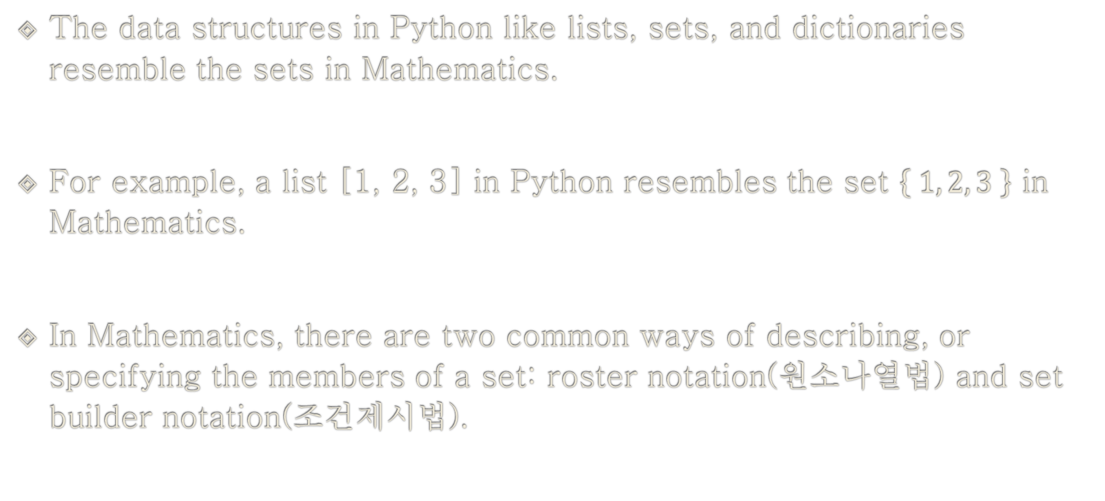
Why Comprehensions?
The data structures in Python like lists, sets, and dictionaries resemble the sets in Mathematics.
For example, a list [1, 2, 3] in Python resembles the set $\left\{ 1, 2, 3 \right\}$ in Mathematics.
In Mathematics, there are two common ways of describing, or specifying the members of a set: roster notation(원소나열법) and set builder notation(조건제시법).

Slide 113
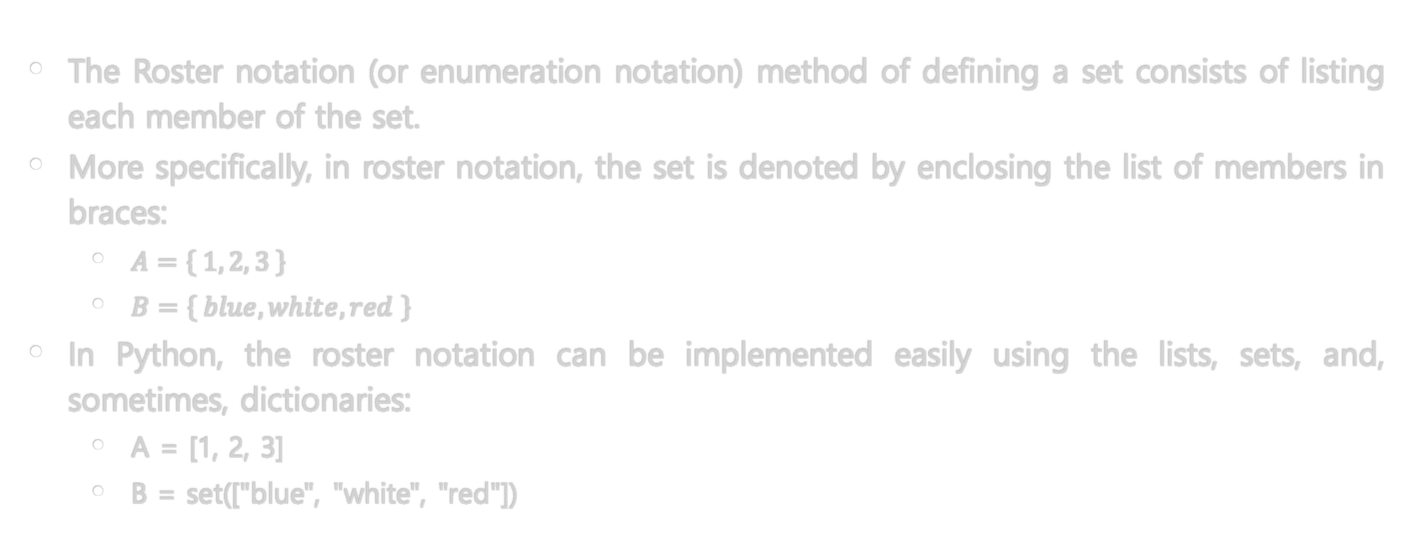
Roster Notation
The Roster notation (or enumeration notation) method of defining a set consists of listing each member of the set.
More specifically, in roster notation, the set is denoted by enclosing the list of members in braces:
$A=\left\{ 1, 2, 3 \right\}$
$B=\left\{ blue, white, red \right\}$
In Python, the roster notation can be implemented easily using the lists, sets, and, sometimes, dictionaries:
A = [1, 2, 3]
B = set(["blue", "white", "red"])

Slide 114
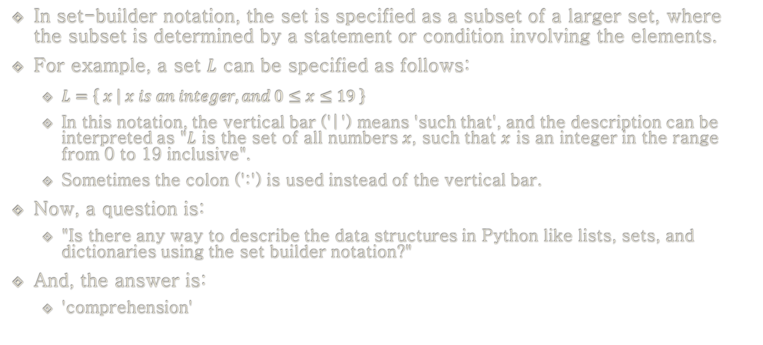
Set-builder Notation
In set-builder notation, the set is specified as a subset of a larger set, where the subset is determined by a statement or condition involving the elements.
For example, a set $L$ can be specified as follows:
$L=\left\{ x | x is an integer, and 0≤x≤19 \right\}$
In this notation, the vertical bar ('|') means 'such that', and the description can be interpreted as "$L$ is the set of all numbers $x$, such that $x$ is an integer in the range from 0 to 19 inclusive".
Sometimes the colon (':') is used instead of the vertical bar.
Now, a question is:
"Is there any way to describe the data structures in Python like lists, sets, and dictionaries using the set builder notation?"
And, the answer is:
'comprehension'

Slide 115
Comprehensions
List Comprehensions
A list comprehension is a syntactic construct for creating a list based on existing lists.
It follows the form of the mathematical set-builder notation (set comprehension) as distinct from the use of map and filter functions.
Types of Comprehensions
List Comprehensions (LC)
Set Comprehensions (SC)
Dictionary Comprehensions (DC)
Generator Expressions (GE)

Slide 116
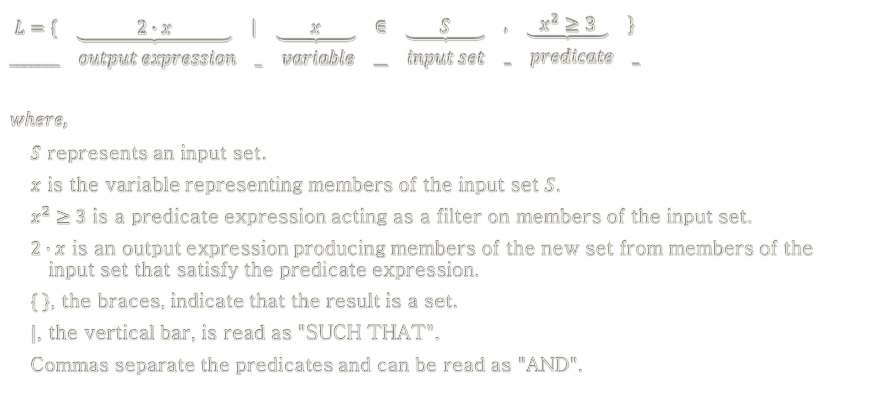
Example: Set-builder Notation in Mathematics
$$\begin{matrix}\begin{matrix}L=\{ & \underbrace{ 2∙x } & \begin{matrix}| & \underbrace{ x } & \begin{matrix}∈ & \underbrace{ S } & \begin{matrix}, & \underbrace{ x^{2}≥3 } & \}\end{matrix}\end{matrix}\end{matrix}\end{matrix} \\ \begin{matrix}_______ & output expression & \begin{matrix}_ & variable & \begin{matrix}__ & input set & \begin{matrix}_ & predicate & _\end{matrix}\end{matrix}\end{matrix}\end{matrix}\end{matrix}$$
$$where,$$
$S$ represents an input set.
$x$ is the variable representing members of the input set $S$.
$x^{2}≥3$ is a predicate expression acting as a filter on members of the input set.
$2∙x$ is an output expression producing members of the new set from members of the input set that satisfy the predicate expression.
$\{ \}$, the braces, indicate that the result is a set.
$|$, the vertical bar, is read as "SUCH THAT".
Commas separate the predicates and can be read as "AND".

Slide 117
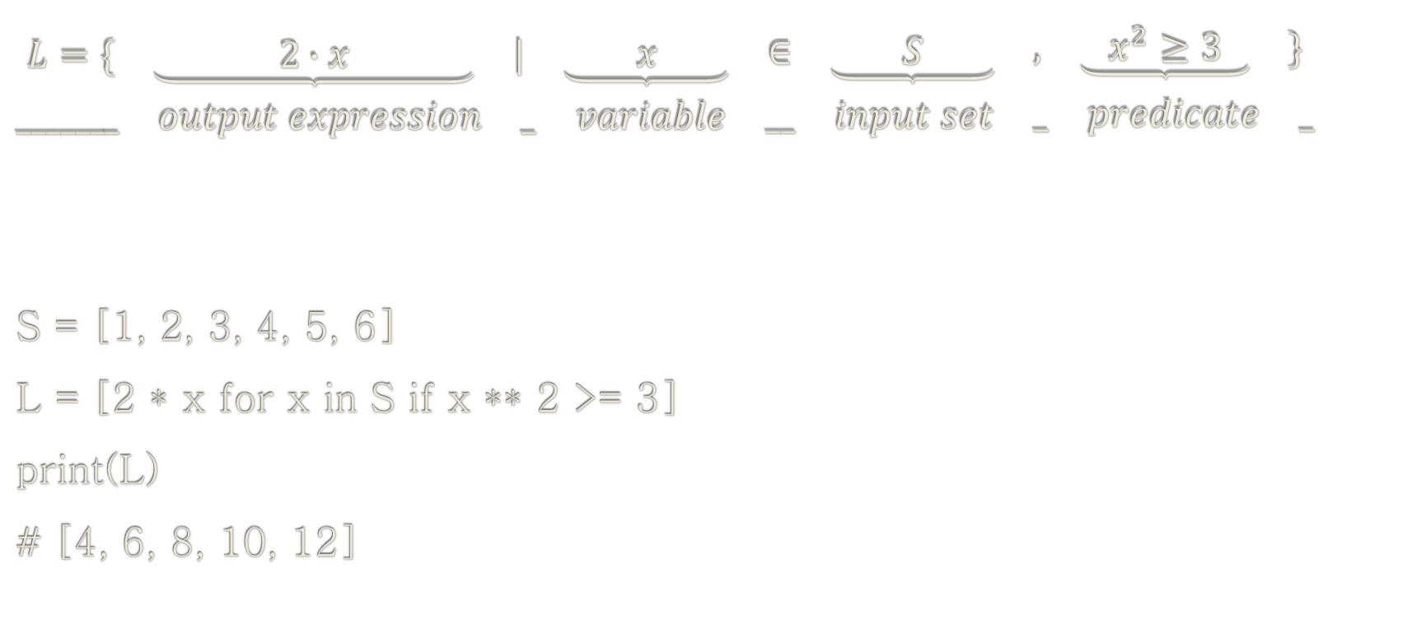
Set-builder Notation in Mathematics vs. List Comprehensions in Python
$$\begin{matrix}\begin{matrix}L=\{ & \underbrace{ 2∙x } & \begin{matrix}| & \underbrace{ x } & \begin{matrix}∈ & \underbrace{ S } & \begin{matrix}, & \underbrace{ x^{2}≥3 } & \}\end{matrix}\end{matrix}\end{matrix}\end{matrix} \\ \begin{matrix}_______ & output expression & \begin{matrix}_ & variable & \begin{matrix}__ & input set & \begin{matrix}_ & predicate & _\end{matrix}\end{matrix}\end{matrix}\end{matrix}\end{matrix}$$
S = [1, 2, 3, 4, 5, 6]
L = [2 * x for x in S if x ** 2 >= 3]
print(L)
# [4, 6, 8, 10, 12]

Slide 118
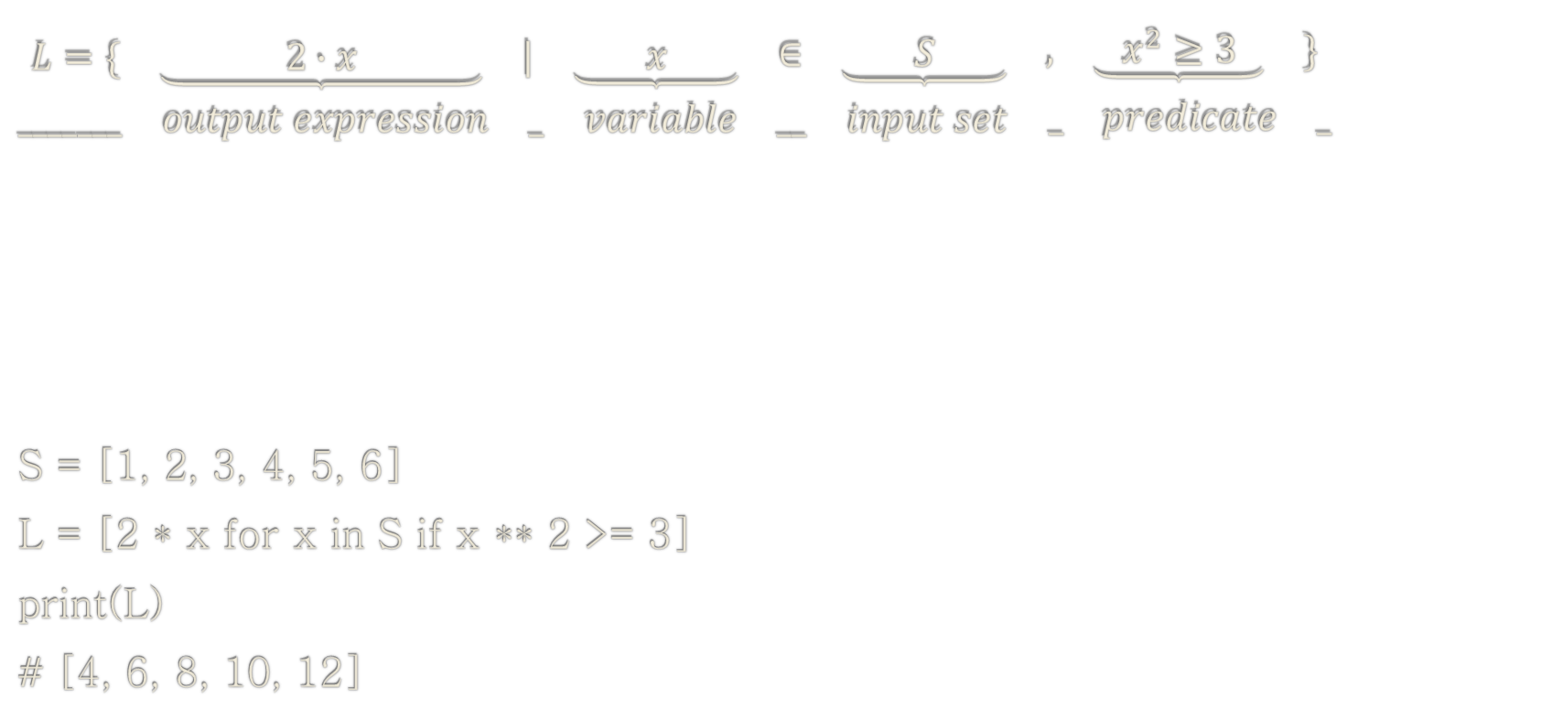
Set-builder Notation in Mathematics vs. List Comprehensions in Python
$$\begin{matrix}\begin{matrix}L=\{ & \underbrace{ 2∙x } & \begin{matrix}| & \underbrace{ x } & \begin{matrix}∈ & \underbrace{ S } & \begin{matrix}, & \underbrace{ x^{2}≥3 } & \}\end{matrix}\end{matrix}\end{matrix}\end{matrix} \\ \begin{matrix}_______ & output expression & \begin{matrix}_ & variable & \begin{matrix}__ & input set & \begin{matrix}_ & predicate & _\end{matrix}\end{matrix}\end{matrix}\end{matrix}\end{matrix}$$
S = [1, 2, 3, 4, 5, 6]
L = [2 * x for x in S if x ** 2 >= 3]
print(L)
# [4, 6, 8, 10, 12]

Slide 119
Set-builder Notation in Mathematics vs. List Comprehensions in Python
$$\begin{matrix}\begin{matrix}L=\{ & \underbrace{ 2∙x } & \begin{matrix}| & \underbrace{ x } & \begin{matrix}∈ & \underbrace{ S } & \begin{matrix}, & \underbrace{ x^{2}≥3 } & \}\end{matrix}\end{matrix}\end{matrix}\end{matrix} \\ \begin{matrix}_______ & output expression & \begin{matrix}_ & variable & \begin{matrix}__ & input set & \begin{matrix}_ & predicate & _\end{matrix}\end{matrix}\end{matrix}\end{matrix}\end{matrix}$$
S = [1, 2, 3, 4, 5, 6]
L = [2 * x for x in S if x ** 2 >= 3]
print(L)
# [4, 6, 8, 10, 12]

Slide 120
Set-builder Notation in Mathematics vs. List Comprehensions in Python
$$\begin{matrix}\begin{matrix}L=\{ & \underbrace{ 2∙x } & \begin{matrix}| & \underbrace{ x } & \begin{matrix}∈ & \underbrace{ S } & \begin{matrix}, & \underbrace{ x^{2}≥3 } & \}\end{matrix}\end{matrix}\end{matrix}\end{matrix} \\ \begin{matrix}_______ & output expression & \begin{matrix}_ & variable & \begin{matrix}__ & input set & \begin{matrix}_ & predicate & _\end{matrix}\end{matrix}\end{matrix}\end{matrix}\end{matrix}$$
S = [1, 2, 3, 4, 5, 6]
L = [2 * x for x in S if x ** 2 >= 3]
print(L)
# [4, 6, 8, 10, 12]

Slide 121
Set-builder Notation in Mathematics vs. List Comprehensions in Python
$$\begin{matrix}\begin{matrix}L=\{ & \underbrace{ 2∙x } & \begin{matrix}| & \underbrace{ x } & \begin{matrix}∈ & \underbrace{ S } & \begin{matrix}, & \underbrace{ x^{2}≥3 } & \}\end{matrix}\end{matrix}\end{matrix}\end{matrix} \\ \begin{matrix}_______ & output expression & \begin{matrix}_ & variable & \begin{matrix}__ & input set & \begin{matrix}_ & predicate & _\end{matrix}\end{matrix}\end{matrix}\end{matrix}\end{matrix}$$
S = [1, 2, 3, 4, 5, 6]
L = [2 * x for x in S if x ** 2 >= 3]
print(L)
# [4, 6, 8, 10, 12]

Slide 122
Set-builder Notation in Mathematics vs. List Comprehensions in Python
$$\begin{matrix}\begin{matrix}L=\{ & \underbrace{ 2∙x } & \begin{matrix}| & \underbrace{ x } & \begin{matrix}∈ & \underbrace{ S } & \begin{matrix}, & \underbrace{ x^{2}≥3 } & \}\end{matrix}\end{matrix}\end{matrix}\end{matrix} \\ \begin{matrix}_______ & output expression & \begin{matrix}_ & variable & \begin{matrix}__ & input set & \begin{matrix}_ & predicate & _\end{matrix}\end{matrix}\end{matrix}\end{matrix}\end{matrix}$$
S = [1, 2, 3, 4, 5, 6]
L = [2 * x for x in S if x ** 2 >= 3]
print(L)
# [4, 6, 8, 10, 12]

Slide 123
Learning Objectives
Comprehensions
List Comprehensions (LC)
Set Comprehensions (SC)
Dictionary Comprehensions (DC)
Generator Expressions (GE)

Slide 124
Example: List Comprehensions
S1 = [1, 2, 3, 4, 5]
L1 = [x ** 2 for x in S1]
print(L1)
L2 = [x ** 2 if x >= 3 else "NA" for x in S1]
print(L2)
# [1, 4, 9, 16, 25]
# ['NA', 'NA', 9, 16, 25]

Slide 125
Example: List Comprehensions
S1 = [1, 2, 3, 4, 5]
L1 = [x ** 2 for x in S1 if x >= 3]
print(L1)
L2 = [x ** 2 if x >= 3 else "NA" for x in S1 if x >= 3]
print(L2)
# [9, 16, 25]
# [9, 16, 25]

Slide 126
Example: List Comprehensions
S1 = [1, 2, 3, 4, 5]
L1 = [x ** 2 for x in S1 if x >= 3 if x < 5]
print(L1)
L2 = [x ** 2 if x >= 3 else "NA" for x in S1 if x >= 3 if x < 5]
print(L2)
# [9, 16]
# [9, 16]

Slide 127
Example: List Comprehensions
S1 = [1, 2, 3, 4, 5]
S2 = ["A", "B", "C", "D", "E"]
L1 = [str(x1 ** 2) + x2 for x1 in S1 for x2 in S2]
print(L1)
L2 = [str(x1 ** 2) + x2 if x1 >= 3 else "NA" for x1 in S1 for x2 in S2]
print(L2)
# ['1A', '1B', '1C', '1D', '1E', '4A', '4B', '4C', '4D', '4E', '9A', '9B', '9C', '9D', '9E', '16A', '16B', '16C', '16D', '16E', '25A', '25B', '25C', '25D', '25E']
# ['NA', 'NA', 'NA', 'NA', 'NA', 'NA', 'NA', 'NA', 'NA', 'NA', '9A', '9B', '9C', '9D', '9E', '16A', '16B', '16C', '16D', '16E', '25A', '25B', '25C', '25D', '25E']

Slide 128
Example: List Comprehensions
S1 = [1, 2, 3, 4, 5]
S2 = ["A", "B", "C", "D", "E"]
L1 = [str(x1 ** 2) + x2 for x1 in S1 if x1 >= 3 for x2 in S2]
print(L1)
L2 = [str(x1 ** 2) + x2 if x1 >= 3 else "NA" for x1 in S1 if x1 >= 3 for x2 in S2]
print(L2)
# ['9A', '9B', '9C', '9D', '9E', '16A', '16B', '16C', '16D', '16E', '25A', '25B', '25C', '25D', '25E']
# ['9A', '9B', '9C', '9D', '9E', '16A', '16B', '16C', '16D', '16E', '25A', '25B', '25C', '25D', '25E']

Slide 129
Example: List Comprehensions
S1 = [1, 2, 3, 4, 5]
S2 = ["A", "B", "C", "D", "E"]
L1 = [str(x1 ** 2) + x2 for x1 in S1 for x2 in S2 if x2 <= "C"]
print(L1)
L2 = [str(x1 ** 2) + x2 if x1 >= 3 else "NA" for x1 in S1 for x2 in S2 if x2 <= "C"]
print(L2)
# ['1A', '1B', '1C', '4A', '4B', '4C', '9A', '9B', '9C', '16A', '16B', '16C', '25A', '25B', '25C']
# ['NA', 'NA', 'NA', 'NA', 'NA', 'NA', '9A', '9B', '9C', '16A', '16B', '16C', '25A', '25B', '25C']

Slide 130
Example: List Comprehensions
S1 = [1, 2, 3, 4, 5]
S2 = ["A", "B", "C", "D", "E"]
L1 = [str(x1 ** 2) + x2 for x1 in S1 if x1 >= 3 for x2 in S2 if x2 <= "C"]
print(L1)
L2 = [str(x1 ** 2) + x2 if x1 >= 3 else "NA" for x1 in S1 if x1 >= 3 for x2 in S2 if x2 <= "C"]
print(L2)
# ['9A', '9B', '9C', '16A', '16B', '16C', '25A', '25B', '25C']
# ['9A', '9B', '9C', '16A', '16B', '16C', '25A', '25B', '25C']

Slide 131
Example: Removing All Special Characters (revisited)
s = "abc@#234"
print(s)
l = [e for e in s if e.isalnum()] # List Comprehension
print(l)
# ['a', 'b', 'c', '2', '3', '4']
t = "".join(l)
print(t)
# abc234
t = "".join(e for e in s if e.isalnum()) # [] not necessary
print(t)
# abc234

Slide 132
Learning Objectives
Comprehensions
List Comprehensions (LC)
Set Comprehensions (SC)
Dictionary Comprehensions (DC)
Generator Expressions (GE)

Slide 133
Example: Set Comprehensions
S1 = [1, 2, 3, 4, 5]
L1 = {x ** 2 for x in S1}
print(L1)
L2 = {x ** 2 if x >= 3 else "NA" for x in S1}
print(L2)
# {1, 4, 9, 16, 25}
# {16, 9, 'NA', 25}
cf. List Comprehensions
# [1, 4, 9, 16, 25]
# ['NA', 'NA', 9, 16, 25]

Slide 134
Learning Objectives
Comprehensions
List Comprehensions (LC)
Set Comprehensions (SC)
Dictionary Comprehensions (DC)
Generator Expressions (GE)

Slide 135
Example: Dictionary Comprehensions
S1 = [1, 2, 3, 4, 5]
L1 = {str(x): x ** 2 for x in S1}
print(L1)
L2 = {str(x): x ** 2 if x >= 3 else "NA" for x in S1}
print(L2)
# {'1': 1, '2': 4, '3': 9, '4': 16, '5': 25}
# {'1': 'NA', '2': 'NA', '3': 9, '4': 16, '5': 25}

Slide 136
Example: Dictionary Comprehensions
S1 = [1, 2, 3, 4, 5]
L1 = {str(x): x ** 2 for x in S1 if x >= 3}
print(L1)
L2 = {str(x): x ** 2 if x >= 3 else "NA" for x in S1 if x >= 3}
print(L2)
# {'3': 9, '4': 16, '5': 25}
# {'3': 9, '4': 16, '5': 25}

Slide 137
Example: Dictionary Comprehensions
S1 = [1, 2, 3, 4, 5]
L1 = {str(x): x ** 2 for x in S1 if x >= 3 if x < 5}
print(L1)
L2 = {str(x): x ** 2 if x >= 3 else "NA" for x in S1 if x >= 3 if x < 5}
print(L2)
# {'3': 9, '4': 16}
# {'3': 9, '4': 16}

Slide 138
Example: Dictionary Comprehensions
S1 = [1, 2, 3, 4, 5]
S2 = ["A", "B", "C", "D", "E"]
L1 = {str(x1): str(x1 ** 2) + x2 for x1 in S1 for x2 in S2}
print(L1)
L2 = {str(x1): str(x1 ** 2) + x2 if x1 >= 3 else "NA" for x1 in S1 for x2 in S2}
print(L2)
# {'1': '1E', '2': '4E', '3': '9E', '4': '16E', '5': '25E'}
# {'1': 'NA', '2': 'NA', '3': '9E', '4': '16E', '5': '25E'}
cf. List Comprehensions
# ['1A', '1B', '1C', '1D', '1E', '4A', '4B', '4C', '4D', '4E', '9A', '9B', '9C', '9D', '9E', '16A', '16B', '16C', '16D', '16E', '25A', '25B', '25C', '25D', '25E']
# ['NA', 'NA', 'NA', 'NA', 'NA', 'NA', 'NA', 'NA', 'NA', 'NA', '9A', '9B', '9C', '9D', '9E', '16A', '16B', '16C', '16D', '16E', '25A', '25B', '25C', '25D', '25E']

Slide 139
Example: Dictionary Comprehensions
S1 = [1, 2, 3, 4, 5]
S2 = ["A", "B", "C", "D", "E"]
L1 = {str(x1) + str(x2): str(x1 ** 2) + x2 for x1 in S1 for x2 in S2}
print(L1)
L2 = {str(x1) + str(x2): str(x1 ** 2) + x2 if x1 >= 3 else "NA" for x1 in S1 for x2 in S2}
print(L2)
# {'1A': '1A', '1B': '1B', '1C': '1C', '1D': '1D', '1E': '1E', '2A': '4A', '2B': '4B', '2C': '4C', '2D': '4D', '2E': '4E', '3A': '9A', '3B': '9B', '3C': '9C', '3D': '9D', '3E': '9E', '4A': '16A', '4B': '16B', '4C': '16C', '4D': '16D', '4E': '16E', '5A': '25A', '5B': '25B', '5C': '25C', '5D': '25D', '5E': '25E'}
# {'1A': 'NA', '1B': 'NA', '1C': 'NA', '1D': 'NA', '1E': 'NA', '2A': 'NA', '2B': 'NA', '2C': 'NA', '2D': 'NA', '2E': 'NA', '3A': '9A', '3B': '9B', '3C': '9C', '3D': '9D', '3E': '9E', '4A': '16A', '4B': '16B', '4C': '16C', '4D': '16D', '4E': '16E', '5A': '25A', '5B': '25B', '5C': '25C', '5D': '25D', '5E': '25E'}
cf. List Comprehensions
# ['1A', '1B', '1C', '1D', '1E', '4A', '4B', '4C', '4D', '4E', '9A', '9B', '9C', '9D', '9E', '16A', '16B', '16C', '16D', '16E', '25A', '25B', '25C', '25D', '25E']
# ['NA', 'NA', 'NA', 'NA', 'NA', 'NA', 'NA', 'NA', 'NA', 'NA', '9A', '9B', '9C', '9D', '9E', '16A', '16B', '16C', '16D', '16E', '25A', '25B', '25C', '25D', '25E']

Slide 140
Example: Dictionary Comprehensions
S1 = [1, 2, 3, 4, 5]
S2 = ["A", "B", "C", "D", "E"]
L1 = {str(x1) + str(x2): str(x1 ** 2) + x2 for x1 in S1 if x1 >= 3 for x2 in S2}
print(L1)
L2 = {str(x1) + str(x2): str(x1 ** 2) + x2 if x1 >= 3 else "NA" for x1 in S1 if x1 >= 3 for x2 in S2}
print(L2)
# {'3A': '9A', '3B': '9B', '3C': '9C', '3D': '9D', '3E': '9E', '4A': '16A', '4B': '16B', '4C': '16C', '4D': '16D', '4E': '16E', '5A': '25A', '5B': '25B', '5C': '25C', '5D': '25D', '5E': '25E'}
# {'3A': '9A', '3B': '9B', '3C': '9C', '3D': '9D', '3E': '9E', '4A': '16A', '4B': '16B', '4C': '16C', '4D': '16D', '4E': '16E', '5A': '25A', '5B': '25B', '5C': '25C', '5D': '25D', '5E': '25E'}

Slide 141
Example: Dictionary Comprehensions
S1 = [1, 2, 3, 4, 5]
S2 = ["A", "B", "C", "D", "E"]
L1 = {str(x1) + str(x2): str(x1 ** 2) + x2 for x1 in S1 for x2 in S2 if x2 <= "C"}
print(L1)
L2 = {str(x1) + str(x2): str(x1 ** 2) + x2 if x1 >= 3 else "NA" for x1 in S1 for x2 in S2 if x2 <= "C"}
print(L2)
# {'1A': '1A', '1B': '1B', '1C': '1C', '2A': '4A', '2B': '4B', '2C': '4C', '3A': '9A', '3B': '9B', '3C': '9C', '4A': '16A', '4B': '16B', '4C': '16C', '5A': '25A', '5B': '25B', '5C': '25C'}
# {'1A': 'NA', '1B': 'NA', '1C': 'NA', '2A': 'NA', '2B': 'NA', '2C': 'NA', '3A': '9A', '3B': '9B', '3C': '9C', '4A': '16A', '4B': '16B', '4C': '16C', '5A': '25A', '5B': '25B', '5C': '25C'}

Slide 142
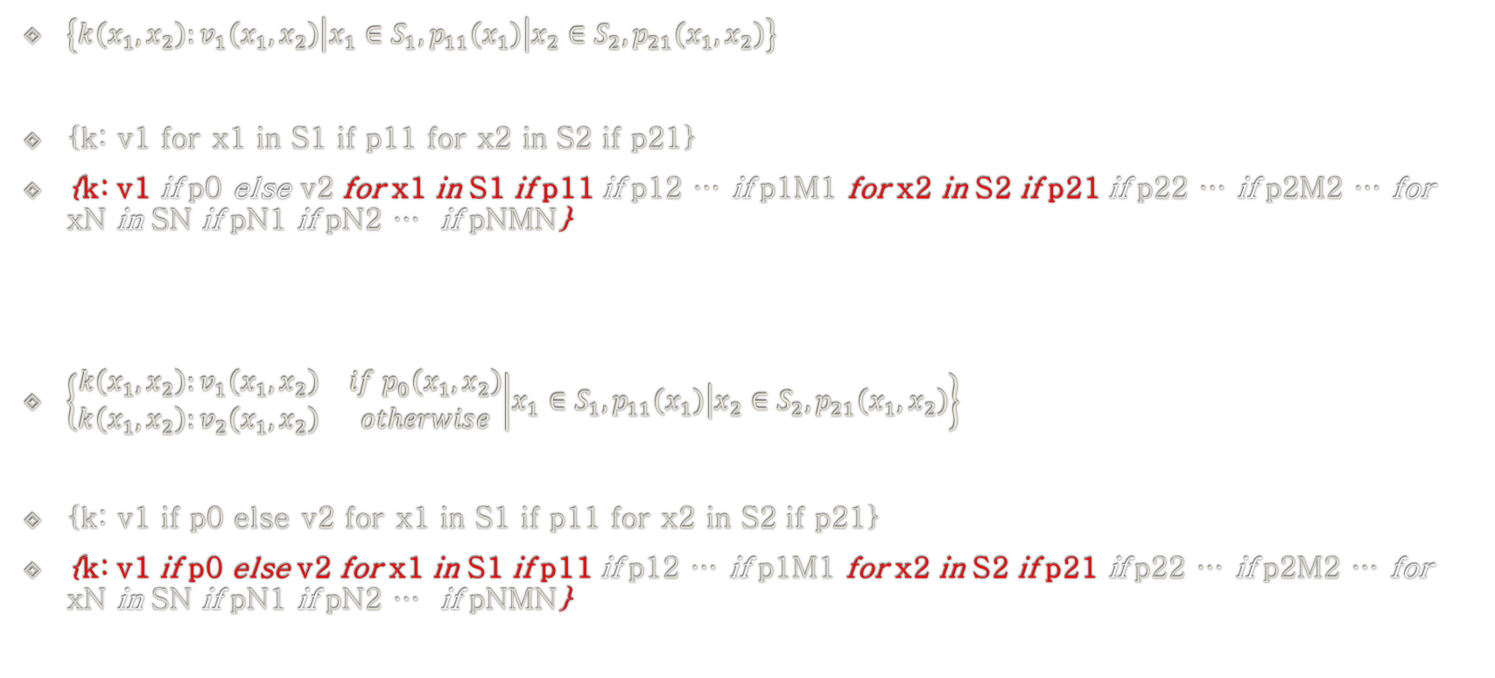
Variations of Dictionary Comprehensions
$\left\{k\left(x_{1},x_{2}\right):v_{1}\left(x_{1},x_{2}\right) | x_{1}∈S_{1},p_{11}\left(x_{1}\right)\left|x_{2}∈S_{2}\right.,p_{21}\left(x_{1},x_{2}\right)\right\}$
{k: v1 for x1 in S1 if p11 for x2 in S2 if p21}
{k: v1 if p0 else v2 for x1 in S1 if p11 if p12 … if p1M1 for x2 in S2 if p21 if p22 … if p2M2 … for xN in SN if pN1 if pN2 … if pNMN}
$\left\{\begin{matrix}k\left(x_{1},x_{2}\right):v_{1}\left(x_{1},x_{2}\right) & if p_{0}\left(x_{1},x_{2}\right) \\ k\left(x_{1},x_{2}\right):v_{2}\left(x_{1},x_{2}\right) & otherwise\end{matrix} | x_{1}∈S_{1},p_{11}\left(x_{1}\right)\left|x_{2}∈S_{2}\right.,p_{21}\left(x_{1},x_{2}\right)\right\}$
{k: v1 if p0 else v2 for x1 in S1 if p11 for x2 in S2 if p21}
{k: v1 if p0 else v2 for x1 in S1 if p11 if p12 … if p1M1 for x2 in S2 if p21 if p22 … if p2M2 … for xN in SN if pN1 if pN2 … if pNMN}

Slide 143
Example: Dictionary Comprehensions
S1 = [1, 2, 3, 4, 5]
S2 = ["A", "B", "C", "D", "E"]
L1 = {str(x1) + str(x2): str(x1 ** 2) + x2 for x1 in S1 if x1 >= 3 for x2 in S2 if x2 <= "C"}
print(L1)
L2 = {str(x1) + str(x2): str(x1 ** 2) + x2 if x1 >= 3 else "NA" for x1 in S1 if x1 >= 3 for x2 in S2 if x2 <= "C"}
print(L2)
# {'3A': '9A', '3B': '9B', '3C': '9C', '4A': '16A', '4B': '16B', '4C': '16C', '5A': '25A', '5B': '25B', '5C': '25C'}
# {'3A': '9A', '3B': '9B', '3C': '9C', '4A': '16A', '4B': '16B', '4C': '16C', '5A': '25A', '5B': '25B', '5C': '25C'}

Slide 144
Learning Objectives
Comprehensions
List Comprehensions (LC)
Set Comprehensions (SC)
Dictionary Comprehensions (DC)
Generator Expressions (GE)

Slide 145
Steps in Using Generator Expressions
Step 1) Define a generator expression
Syntax: refer to the previous slides
Step 2) Repeat calling the generator expression
Syntax: next(generator)

Slide 146
Example: Generator Expressions
gXX = (x ** 2 for x in range(10))
print(gXX)
print(next(gXX)) # x: 0 → 0
print(next(gXX)) # x: 1 → 1
print(next(gXX)) # x: 2 → 4
print(next(gXX)) # x: 3 → 9

Slide 147
Example: Generator Expressions
gXX = (x ** 2 for x in range(10))
print(gXX)
for i in range(10):
print(next(gXX))
# <generator object <genexpr> at 0x000001F5945D15F0>
# 0
# 1
# 4
# 9
# 16
# 25
# 36
# 49
# 64
# 81

Slide 148
Example: Generator Expressions
gXX = (x ** 2 for x in range(10))
print(gXX)
for i in range(11):
print(next(gXX)) # ERROR

Slide 149
Example: Generator Expressions
gXX = (x ** 2 for x in range(10))
print(gXX)
for i in range(10):
print(next(gXX))
gXX = (x ** 2 for x in range(10))
print(gXX)
for i in range(11):
print(next(gXX))
# ERROR

Slide 150
Example: Generator Expressions
gXX = (x ** 2 for x in range(10))
print(gXX)
for i in range(10):
print(next(gXX))
gXX = (x ** 2 for x in range(10))
print(gXX)
for i in range(11):
print(next(gXX))
# ERROR

Slide 151
Example: Generator Expressions
S1 = [1, 2, 3, 4, 5]
S2 = ["A", "B", "C", "D", "E"]
L1 = (str(x1 ** 2) + x2 for x1 in S1 for x2 in S2 if x2 <= "C")
for i in range(15): # 25?
print(next(L1))

Slide 152
cf. Example: List Comprehensions
S1 = [1, 2, 3, 4, 5]
S2 = ["A", "B", "C", "D", "E"]
L1 = [str(x1 ** 2) + x2 for x1 in S1 for x2 in S2 if x2 <= "C"]
print(L1)
# ['1A', '1B', '1C', '4A', '4B', '4C', '9A', '9B', '9C', '16A', '16B', '16C', '25A', '25B', '25C']

Slide 153
Generator Expressions vs. List Comprehensions
S1 = [1, 2, 3, 4, 5]
S2 = ["A", "B", "C", "D", "E"]
L1 = [str(x1 ** 2) + x2 for x1 in S1 for x2 in S2 if x2 <= "C"]
print(L1)
S1 = [1, 2, 3, 4, 5]
S2 = ["A", "B", "C", "D", "E"]
L1 = (str(x1 ** 2) + x2 for x1 in S1 for x2 in S2 if x2 <= "C")
for i in range(15): # 25?
print(next(L1))

Slide 154
Generator Expressions vs. List Comprehensions
S1 = [1, 2, 3, 4, 5]
S2 = ["A", "B", "C", "D", "E"]
L1 = [str(x1 ** 2) + x2 for x1 in S1 for x2 in S2 if x2 <= "C"]
print(L1)
S1 = [1, 2, 3, 4, 5]
S2 = ["A", "B", "C", "D", "E"]
L1 = (str(x1 ** 2) + x2 for x1 in S1 for x2 in S2 if x2 <= "C")
for i in range(15): # 25?
print(next(L1))

Slide 155
Example: Generator Expressions
gXX = (x ** 2 for x in range(10))
SS = sum(gXX)
print(SS)
# 285

Slide 156
cf. Example: List Comprehensions
L = [x ** 2 for x in range(10)]
SS = sum(L)
print(SS)
# 285

Slide 157
Generator Expressions vs. List Comprehensions
L = [x ** 2 for x in range(10)]
SS = sum(L)
print(SS)
# 285
gXX = (x ** 2 for x in range(10))
SS = sum(gXX)
print(SS)
# 285

Slide 158
Generator Expressions vs. List Comprehensions
L = [x ** 2 for x in range(10)]
SS = sum(L)
print(SS)
# 285
gXX = (x ** 2 for x in range(10))
SS = sum(gXX)
print(SS)
# 285

Slide 159
Summary
Comprehensions
List Comprehensions (LC)
Set Comprehensions (SC)
Dictionary Comprehensions (DC)
Generator Expressions (GE)

Slide 160
End of Python: Comprehensions

Slide 161
Python: Data Structures Dictionaries, Sets, Sequences

